Slide 1



^{An Introduction} ^{to Linear Regression}
^{Oscar Rondon}
^{October 2018}

Slide 2
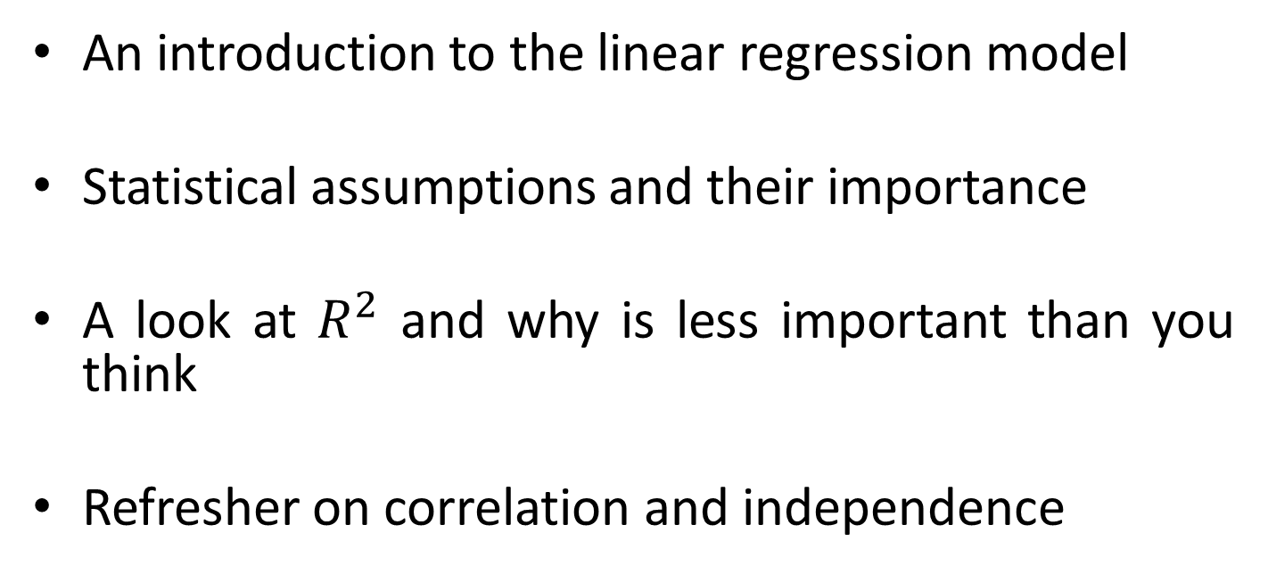
Content
An introduction to the linear regression model
Statistical assumptions and their importance
A look at $R^{2}$ and why is less important than you think
Refresher on correlation and independence

Slide 3
Linear Regression Model
The linear regression model is one of the most basic statistical models used in predictive analysis
The model proceeds by fitting a linear equation to observed paired data to attemp to model the relationship between the two variables
One variable is commonly referred as to the explanatory variable while the other is considered the dependent variable

Slide 4
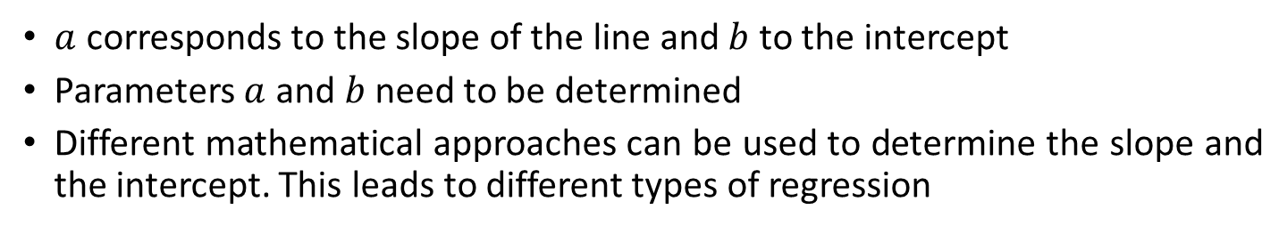
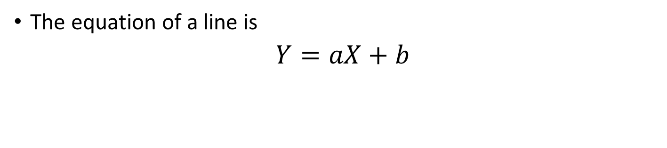
Linear Regression Model
The equation of a line is
$Y=aX+b$
Dependent variable
Explanatory variable
$a$ corresponds to the slope of the line and $b$ to the intercept
Parameters $a$ and $b$need to be determined
Different mathematical approaches can be used to determine the slope and the intercept. This leads to different types of regression

Slide 5




Linear Regression Model
Y
$$Y=aX+b$$
$$Y=aX+b$$
Y
negative slope
positive slope
$$b$$
$$b$$
X
X
Y
$$Y=b$$
Slope = 0
$$b$$
X

Slide 6
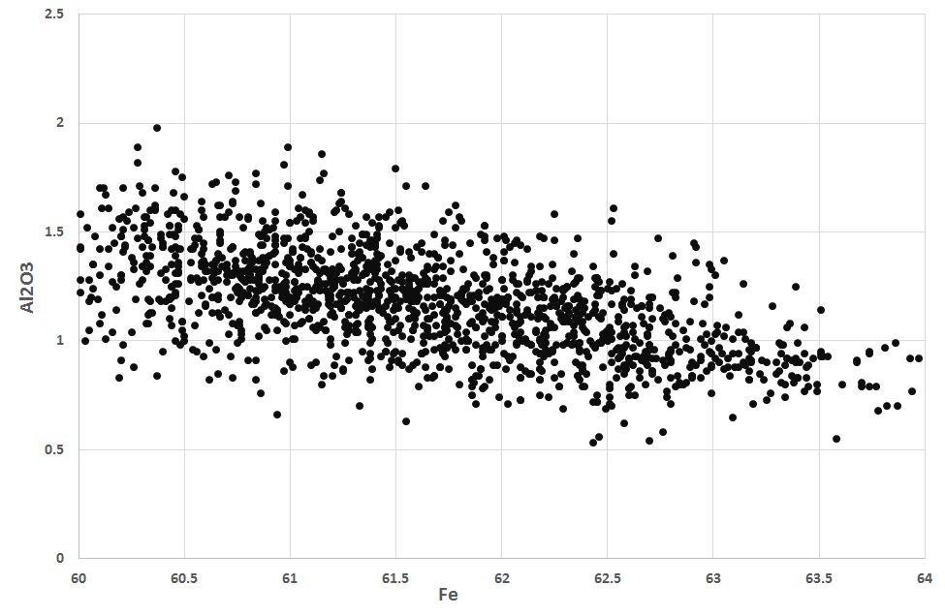
Linear Regression Model
Why do we want to fit a line?
The scatterplot shows the paired data is scattered around a trend line
The line is indicative of the average value of the dependent variable given the explanatory variable

Slide 7

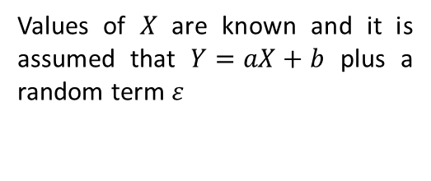

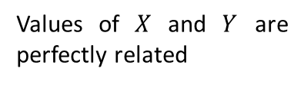


Linear Regression Model
Y
Y
$$Y=aX+b$$
$Y=aX+b$ + $ε$
$$b$$
$$b$$
X
X
Values of $X$ and $Y$ are perfectly related
Values of $X$ are known and it is assumed that $Y=aX+b$ plus a random term $ε$

Slide 8
^{The Statistical Assumptions}
^{Oscar Rondon}
^{October 2018}

Slide 9

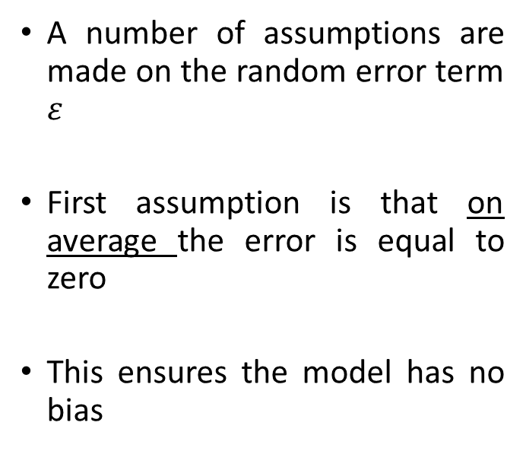
The statistical assumptions
A number of assumptions are made on the random error term $ε$
First assumption is that on average the error is equal to zero
This ensures the model has no bias
Y
$Y−aX+b$ = $ε$
$$b$$
X

Slide 10
The statistical assumptions
Positive bias
Negative bias

Slide 11
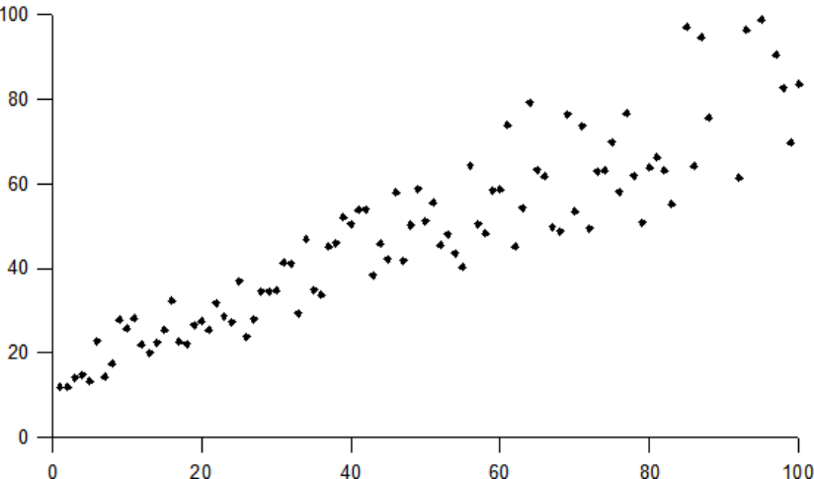
The statistical assumptions
Second assumption is that the variance of the random error term is constant
This is know in statistics as homoscedasticity asummption
Heteroscedasticity refers to the violation of this assumption

Slide 12
The statistical assumptions
Third assumption is that random error term is independent of both the explanatory and dependent variable
Extremely important assumption and provides a way to assess the goodness of the linear model
Scatterplot of the error with either the explanatory or the dependent variable should not show any clear pattern

Slide 13
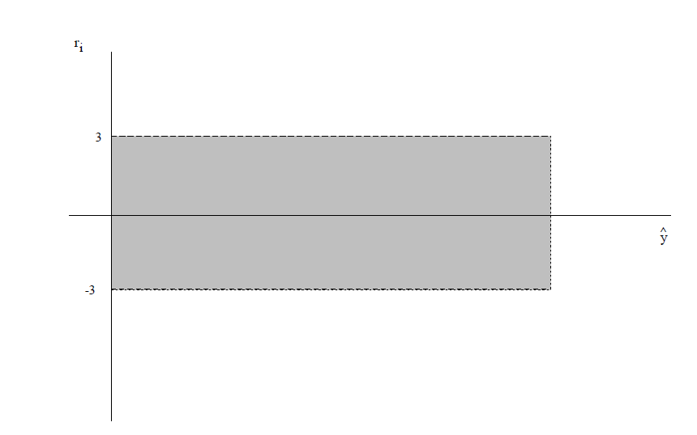
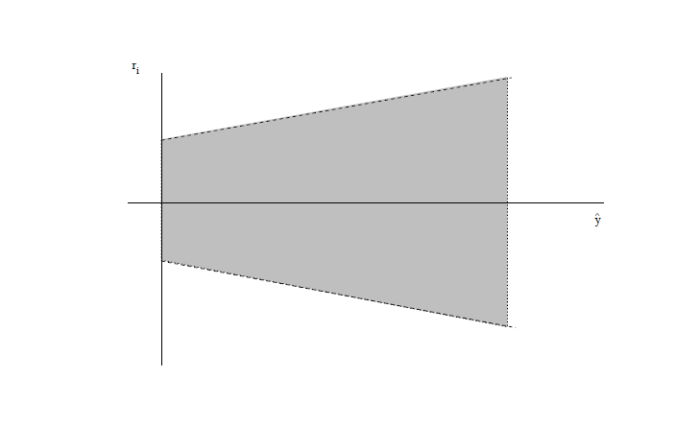
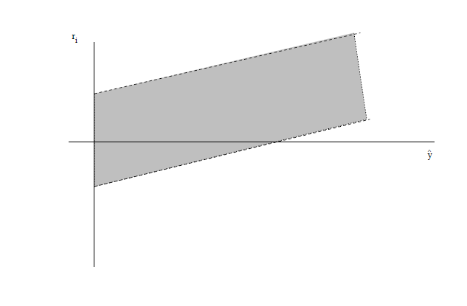
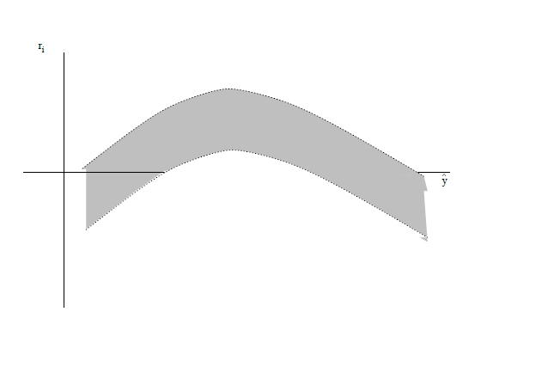
The statistical assumptions
a) Appropriate
b) homoscedasticity violated
c) and d) are indicative that the linear regression model is not adequate
a)
b)
c)
d)

Slide 14
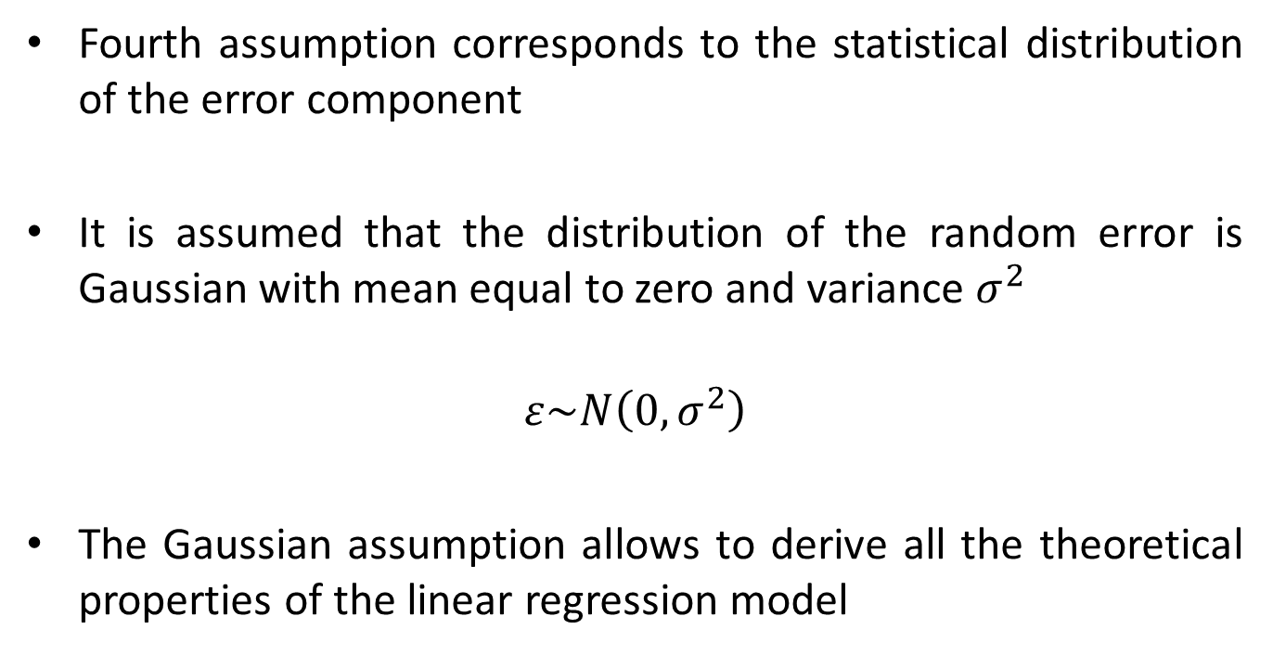
The statistical assumptions
Fourth assumption corresponds to the statistical distribution of the error component
It is assumed that the distribution of the random error is Gaussian with mean equal to zero and variance $σ^{2}$
$$ε\sim N\left(0,σ^{2}\right)$$
The Gaussian assumption allows to derive all the theoretical properties of the linear regression model

Slide 15
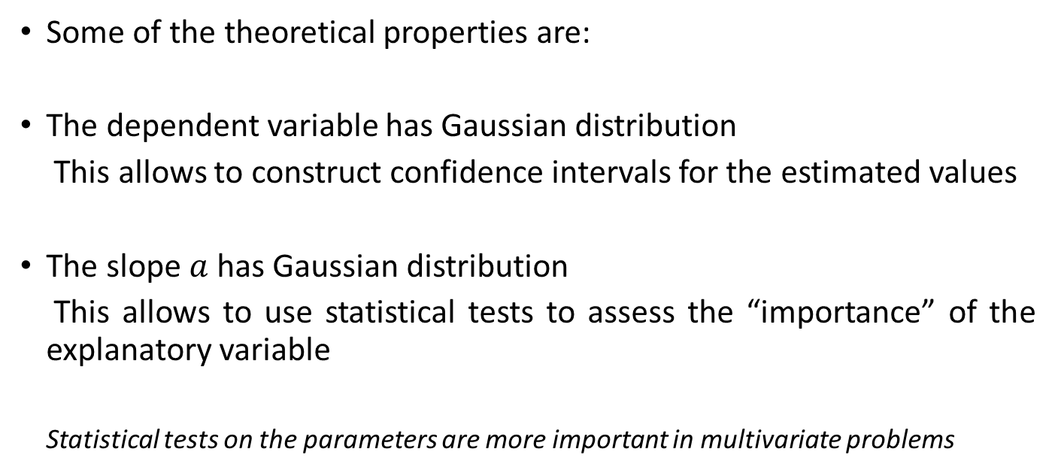
The statistical assumptions
Some of the theoretical properties are:
The dependent variable has Gaussian distribution
This allows to construct confidence intervals for the estimated values
The slope $a$ has Gaussian distribution
This allows to use statistical tests to assess the “importance” of the explanatory variable
Statistical tests on the parameters are more important in multivariate problems

Slide 16
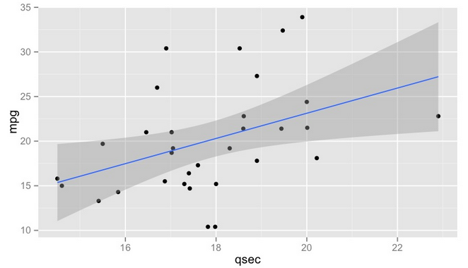
The statistical assumptions
Example of a linear regression model with confidence intervals
Can you anticipate the behaviour of the residuals?
Would you say the linear model is reasonable?

Slide 17
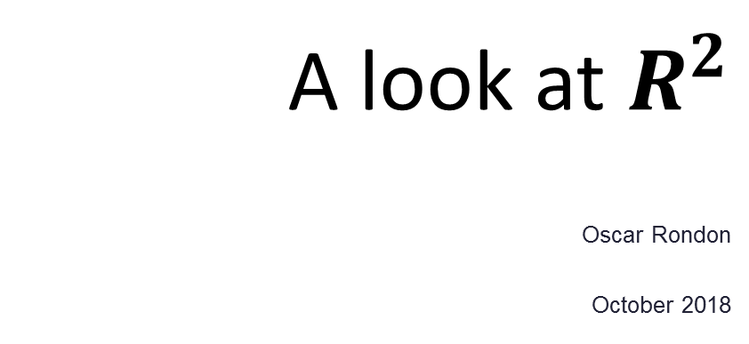
A look at $R^{2}$
^{Oscar Rondon}
^{October 2018}

Slide 18
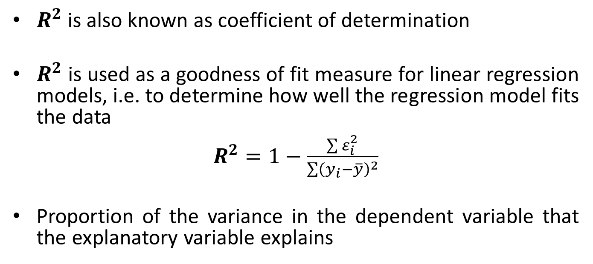

A look at $R^{2}$
$R^{2}$ is also known as coefficient of determination
$R^{2}$ is used as a goodness of fit measure for linear regression models, i.e. to determine how well the regression model fits the data
$R^{2}=1−\frac{\sum{ε_{i}^{2}}}{\sum{{\left(y_{i}−\overline{y}\right)}^{2}}}$
Proportion of the variance in the dependent variable that the explanatory variable explains

Slide 19
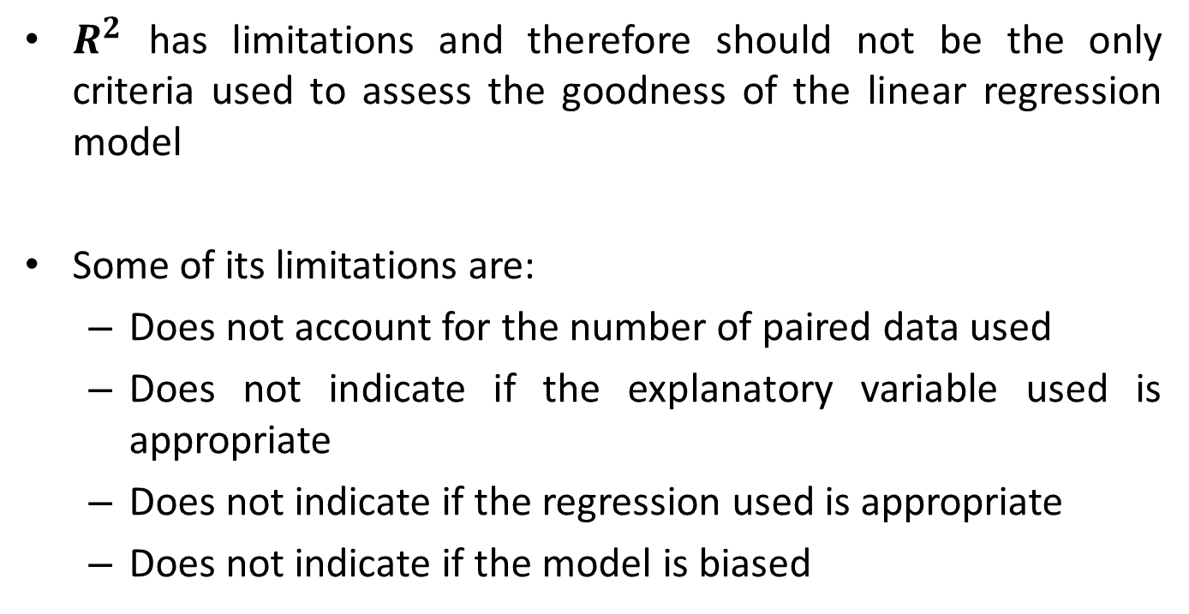

A look at $R^{2}$
$R^{2}$ has limitations and therefore should not be the only criteria used to assess the goodness of the linear regression model
Some of its limitations are:
Does not account for the number of paired data used
Does not indicate if the explanatory variable used is appropriate
Does not indicate if the regression used is appropriate
Does not indicate if the model is biased

Slide 20
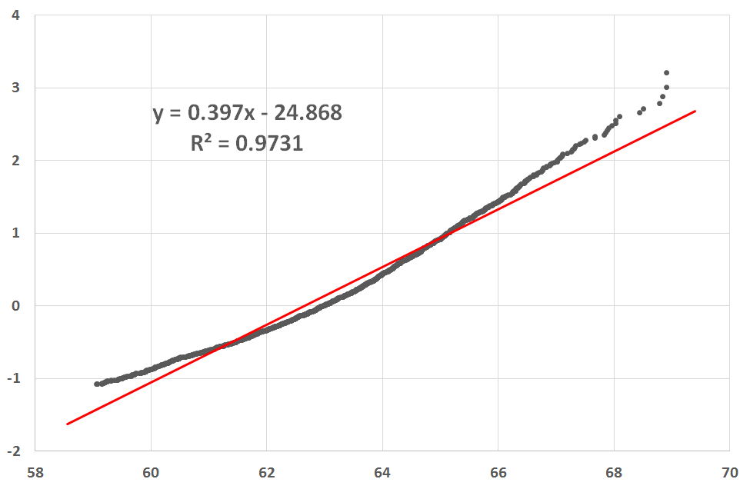

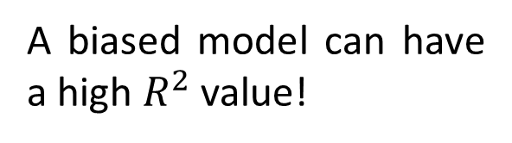
A look at $R^{2}$
A biased model can have a high $R^{2}$ value!

Slide 21
Correlation and Independence
^{Oscar Rondon}
^{October 2018}

Slide 22



Correlation and Independence
Traditional correlation is a measure of the linear relationship between two variables
A correlation value equal to zero does not mean the variables are not related
$$ρ\sim 0.9$$
Y
X
$$ρ\sim 0$$
$$ρ\sim −0.9$$
Y
Y
X
X

Slide 23
Correlation and Independence
The concept of statistical independence is given by the factorisation of the joint probability distribution as the product of the marginal distributions
This means that knowing the value of one of the variables does not tell anything about the value of the other variable
Independence implies no correlation but the reverse is not true

